Slide 1
Biology
Unit 3 Matter and Energy in Living Systems
Lesson 2: Cellular Respiration
Notes:
Learning Objective: Construct explanations about changes in matter and energy during cellular respiration

Slide 2
Can You Explain It?
Unit 3 Lesson 2
How is the process of fuel combustion in a car engine similar to the way the cells in your body release energy stored in fuel?

Slide 3
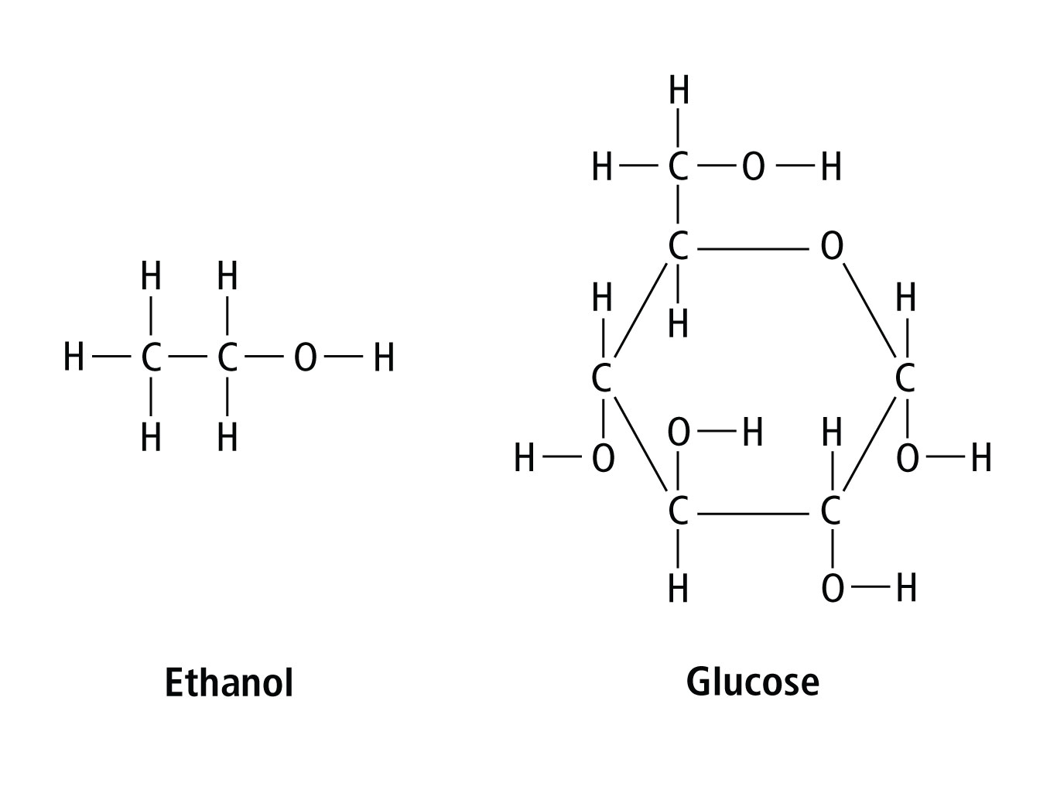
Matter and Energy in Chemical Respiration
Unit 3 Lesson 2
Ethanol is a fuel made from plant material, such as corn. As a renewable energy source, it helps reduce petroleum use. Glucose is a simple sugar that living things use for energy.

Slide 4
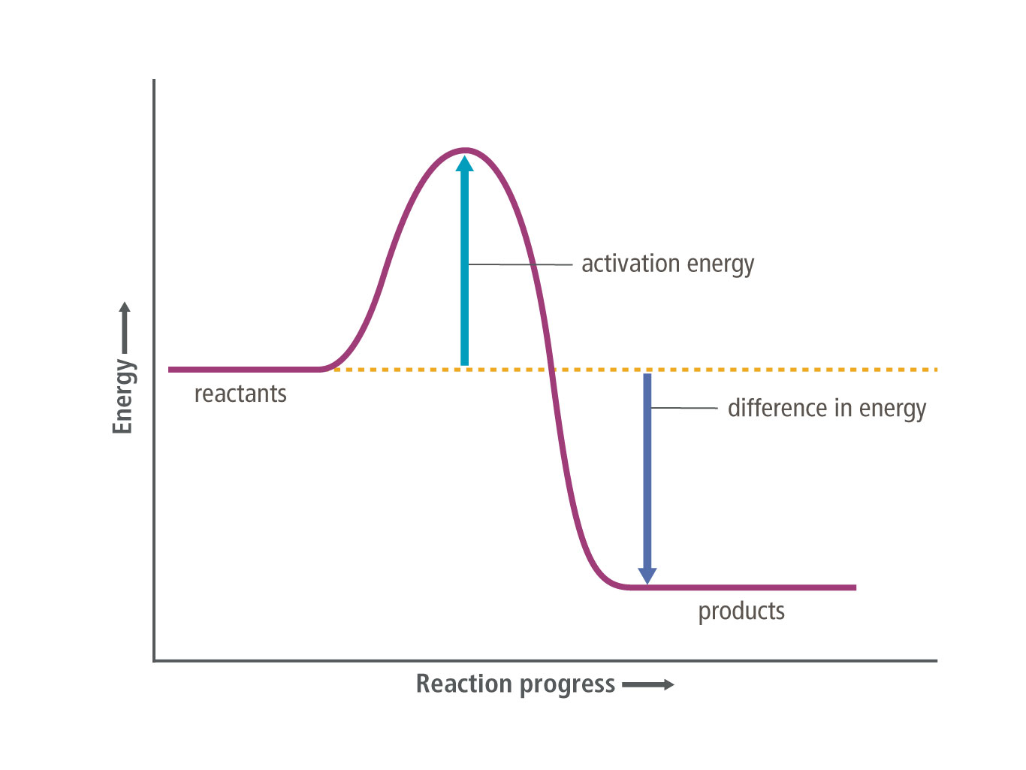
Matter and Energy in Chemical Respiration
Unit 3 Lesson 2
In cars, a combustion reaction provides the energy needed to break these bonds and release energy.
In cells, a similar process called cellular respiration releases chemical energy from sugars and other carbon-based molecules to make ATP when oxygen is present.

Slide 5
Matter and Energy in Chemical Respiration
Unit 3 Lesson 2
Cellular respiration is an aerobic process, which means that it requires oxygen to take place.
Some organisms can produce small amounts of ATP through anaerobic processes, or processes that do not require oxygen.
Cellular respiration takes place inside an organelle called the mitochondrion (plural mitochondria). Mitochondria release the chemical energy required to make ATP.

Slide 6
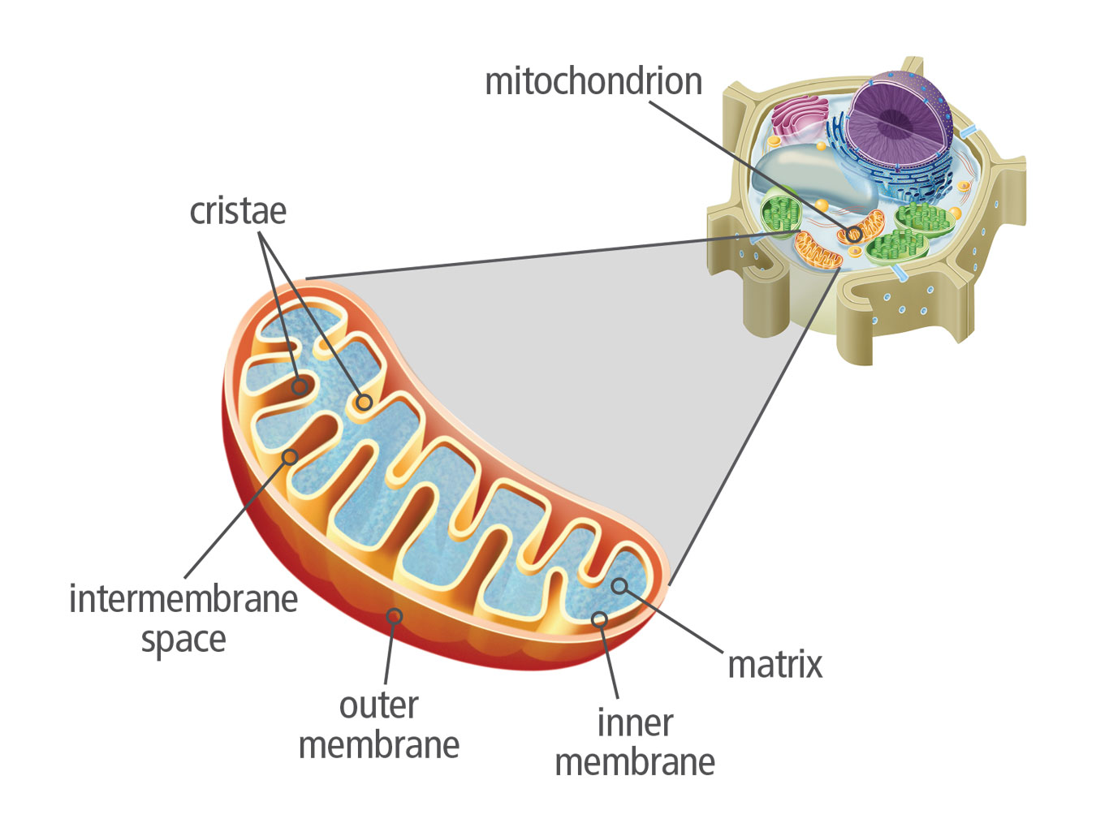
Matter and Energy in Chemical Respiration
Unit 3 Lesson 2
Cite evidence that supports the claim that mitochondria are the "powerhouses of the cell."

Slide 7

Matter and Energy in Chemical Respiration
Unit 3 Lesson 2
MODEL
Sort the following terms into those that occur during photosynthesis and those that occur during cellular respiration. Then place the terms in the correct order.
absorption of sunlight
ATP production
production of sugars
breakdown of sugars

Slide 8
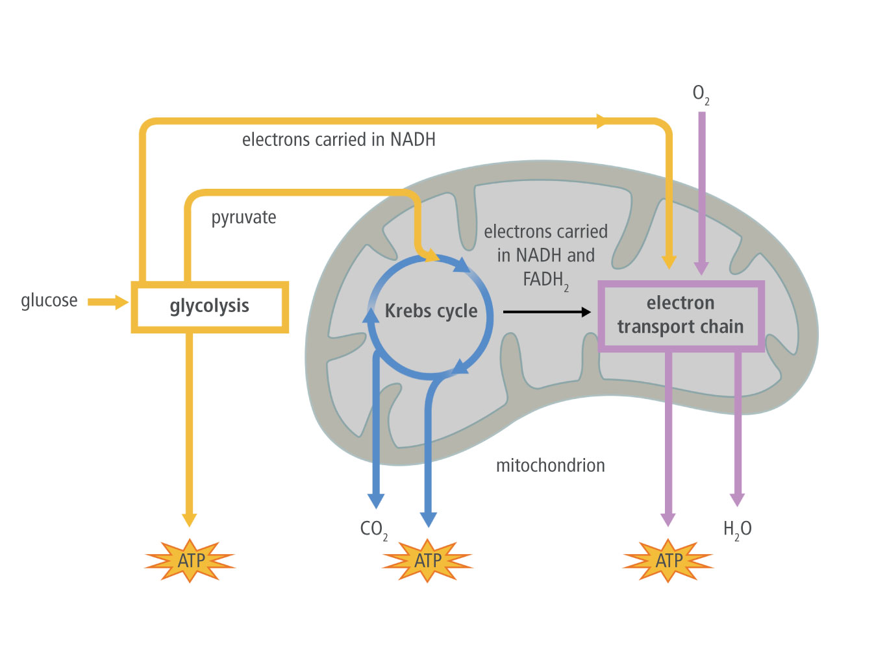
Using Chemical Energy
Unit 3 Lesson 2
The process of glycolysis occurs before the two main stages of cellular respiration: the Krebs cycle and the electron transport chain.

Slide 9
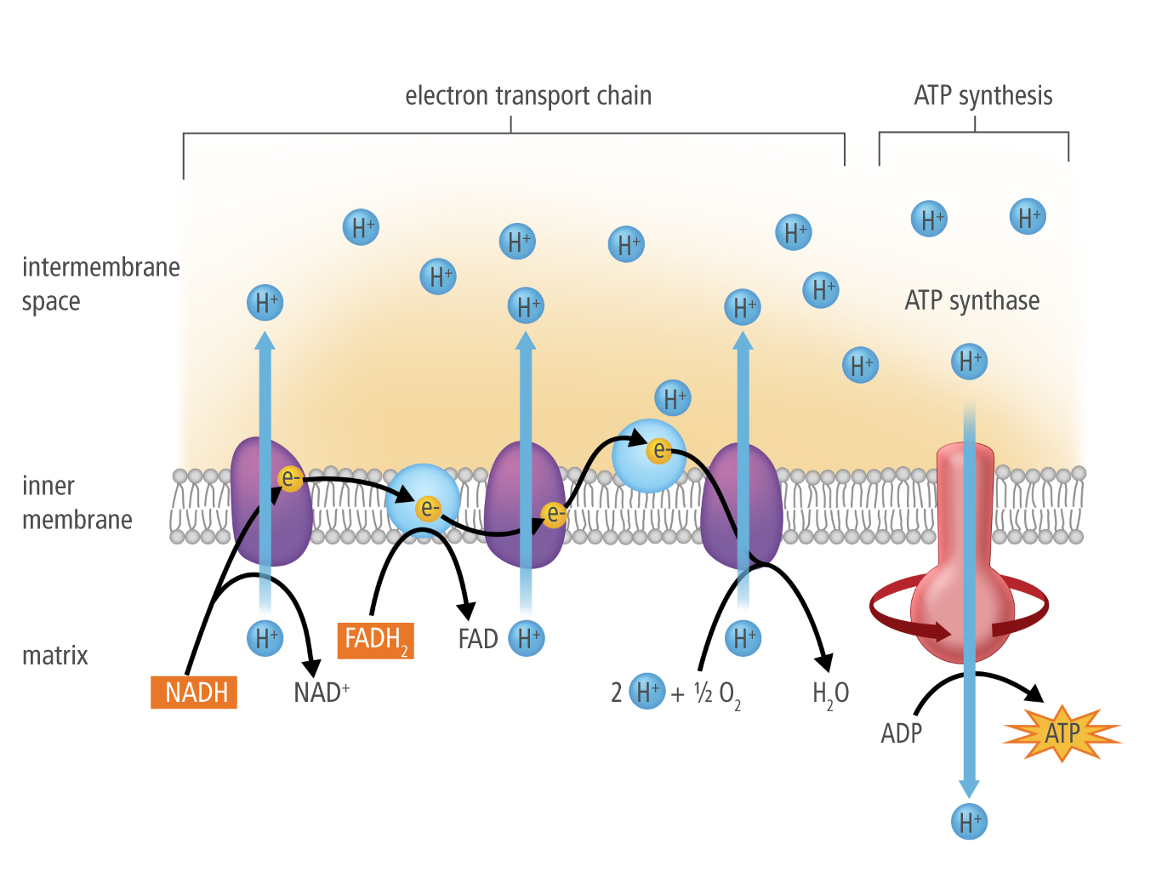
Using Chemical Energy
Unit 3 Lesson 2

Slide 10
Using Chemical Energy
Unit 3 Lesson 2
MODEL
Make a flowchart to summarize the energy transfer from energy-carrying molecules to ATP.

Slide 11

Using Chemical Energy
Unit 3 Lesson 2
During strenuous or prolonged activity, athletes may not be able to sustain the oxygen levels their bodies need. If not enough oxygen is supplied to the cells, anaerobic respiration takes over.

Slide 12
Can You Explain It?
Unit 3 Lesson 2
Construct an explanation for how the breakdown of fuel in a car engine compares to the breakdown of fuel in your body’s cells. Refer to the notes in your Evidence Notebook to answer the following questions:
Look carefully at the equations for both combustion and cellular respiration and compare the inputs and outputs. How can the different inputs result in the same outputs based on what you know about chemical bonds and atoms?
What is missing from the process of combustion that makes it an imperfect model for cellular respiration? Explain your answer.

Slide 13
Image Credits
Unit 3 Lesson 2
basketball players ©HMH

